Slide 1







Harnessing the Power of Convolutional Neural Networks for Accurate Detection of Acute Lymphoblastic Leukemia

Slide 2






Meet the
Groups
MD NURE ALAM NADIM
NURE SABA BINTE ALAM
Tanzim Ikram Sheikh
Sk Muktadir Hossain
22-46986-1
22-46937-1
21-45275-2
21-44989-2

Slide 3

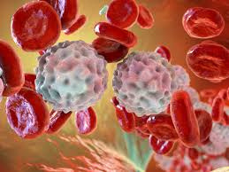
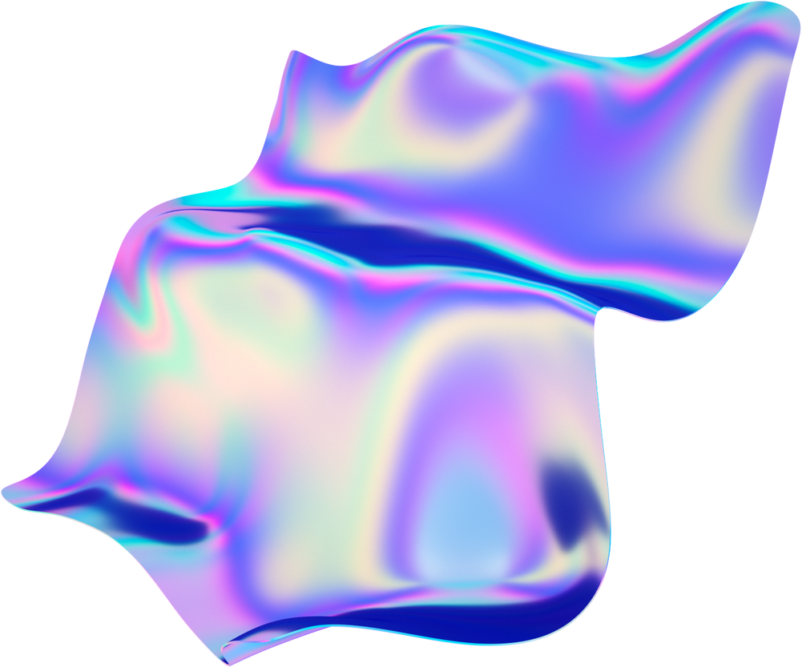

01
Acute lymphoblastic leukemia (ALL) poses diagnostic challenges due to invasive tests and potential misdiagnosis. Leveraging a dataset of 3256 PBS images, captured at Taleqani Hospital, Tehran, Iran, this study explores the potential of convolutional neural networks for accurate ALL detection, promising improved efficiency and reliability in leukemia diagnosis.

Slide 4
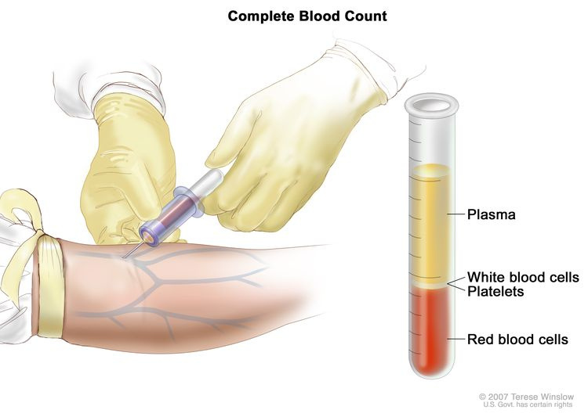
02
Problem Statement
Manual screening for acute lymphoblastic leukemia (ALL) is hindered by subjectivity, reliance on expert pathologists, and potential human error. Existing solutions lack precision in blast cell segmentation and subtype classification, often requiring manual feature extraction. A pressing need exists for an automated system that can accurately detect and classify ALL subtypes, overcoming the limitations of manual screening.

Slide 5
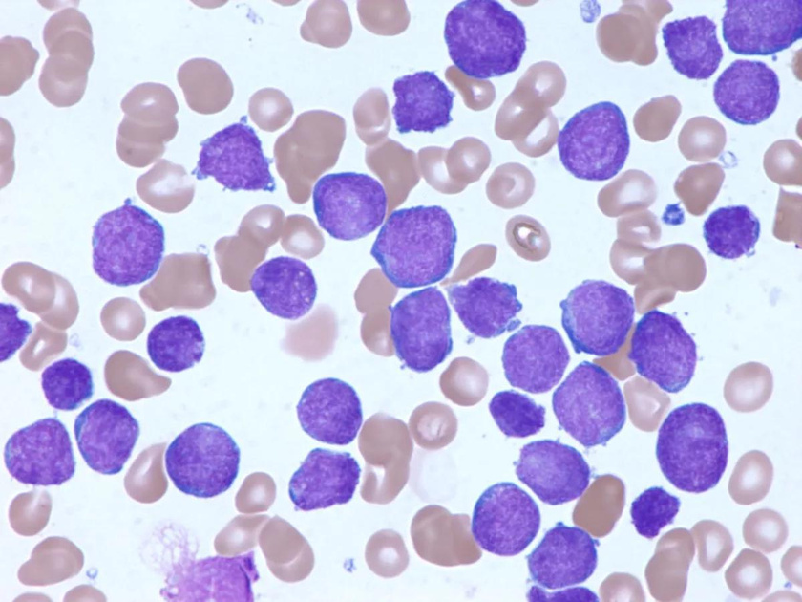
03
Objective:
Develop an automated system using convolutional neural networks (CNNs) to accurately detect and classify acute lymphoblastic leukemia (ALL) subtypes, aiming to eliminate human error and subjectivity in diagnosis while improving efficiency.

Slide 6
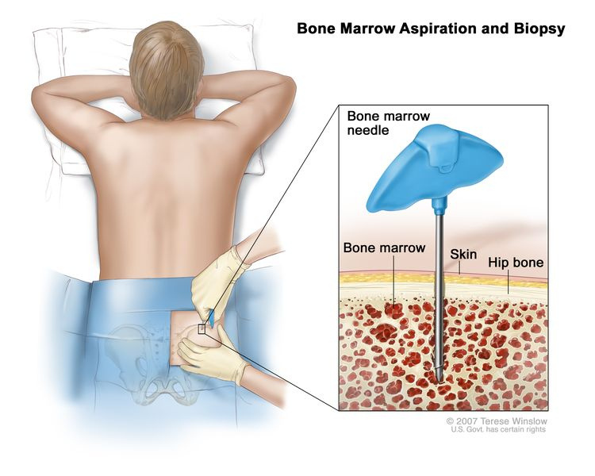
04
Data Collection:
The dataset of 3256 PBS images used in this study was collected from Kaggle, a platform renowned for its high-quality datasets, rated with a usability score of 10. These images were originally captured at Taleqani Hospital in Tehran, Iran, and were meticulously curated for their relevance to acute lymphoblastic leukemia (ALL) diagnosis.

Slide 7

05
Data Validation:
Check for Missing Files: Verify that all files expected to be extracted from the .rar archives are present in the specified folders after extraction. You can compare the list of extracted files with the list of files in the original .rar archives to ensure completeness.
Validate Class Distribution: Ensure that the distribution of images across classes (folders) is balanced. You can calculate the number of images in each class and visualize the class distribution to detect any imbalances.
Image Size Consistency: Check if all images have consistent dimensions (e.g., height and width). Inconsistencies in image sizes can affect the performance of convolutional neural networks (CNNs) during training.

Slide 8

06
Data Preprocessing:
Image Resizing: Resize all images to a consistent size using techniques such as cropping or interpolation. This ensures uniformity in input dimensions for the CNN model.
Data Augmentation: Augment training data with transformations such as rotation, shifting, and flipping to increase the diversity of training samples and enhance model generalization.
Batch Generation: Implement batch generation for training, validation, and testing datasets to efficiently feed data to the CNN model in mini-batches.

Slide 9

Data Normalization:
Normalization: Normalize pixel values of images to a common scale (e.g., [0, 1] or [-1, 1]). Normalization improves model convergence and stability during training.

Slide 10

07
Feature Extraction:
The Conv2D layers in the CNN architecture extract hierarchical features such as edges, textures, and patterns from input images. Each layer learns to detect different levels of abstraction, with increasing complexity in deeper layers. Activation functions like ReLU introduce non-linearity, enhancing feature representation. MaxPooling2D layers downsample feature maps, preserving salient features. The Flatten layer reshapes features into a 1D vector, ready for classification, capturing both low-level and high-level representations essential for accurate classification.

Slide 11

Classification Model
In a sequential manner, the CNN model is constructed, utilizing convolutional layers and max-pooling operations to extract features from input images. These features are then passed through dense layers for classification. Activation functions introduce non-linearity, while dropout regularization mitigates overfitting. Finally, the model is compiled using the Adam optimizer and categorical crossentropy loss, optimizing for accuracy.

Slide 12
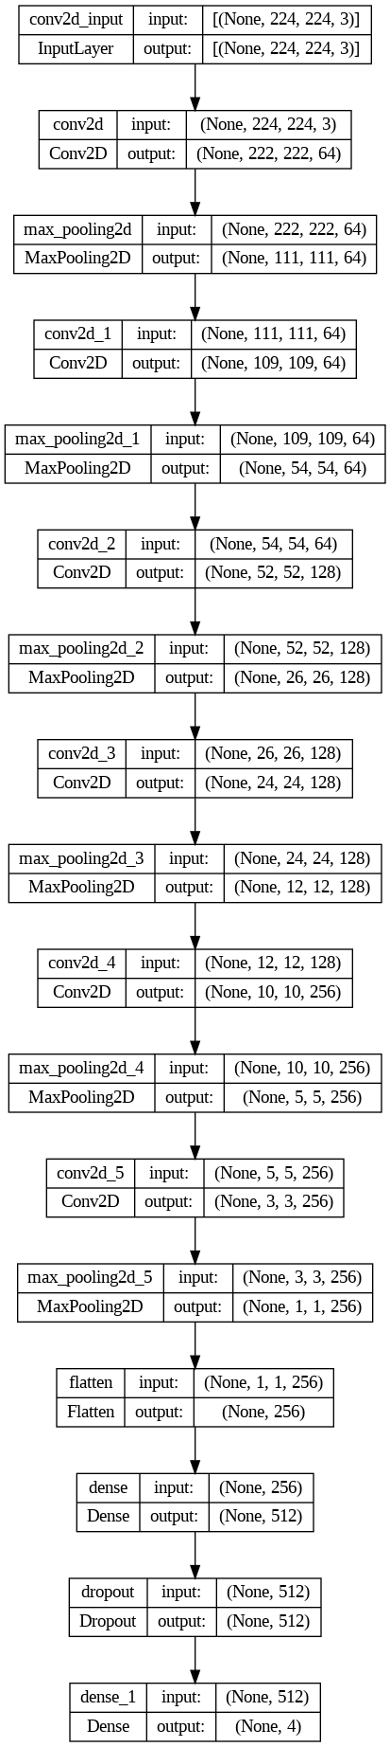
Block Diagram

Slide 13
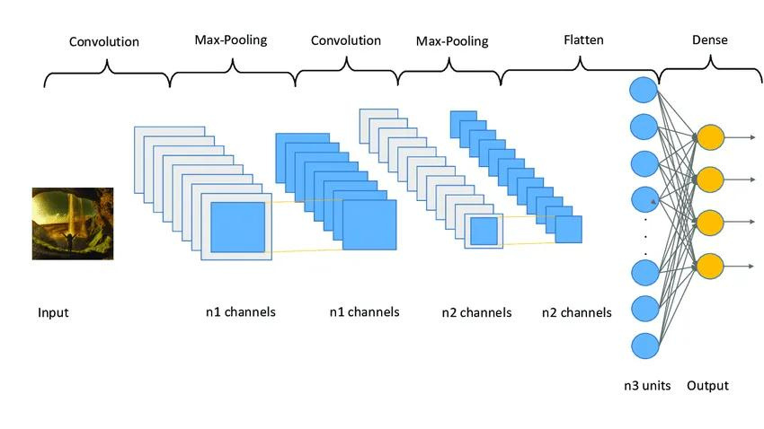

Slide 14
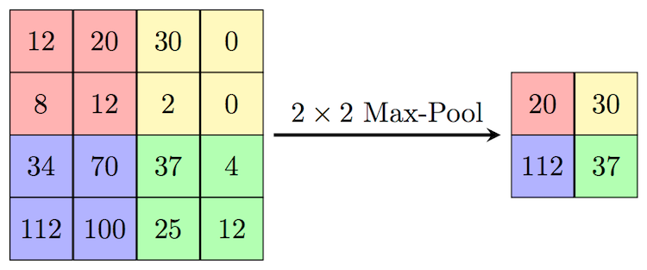

Slide 15
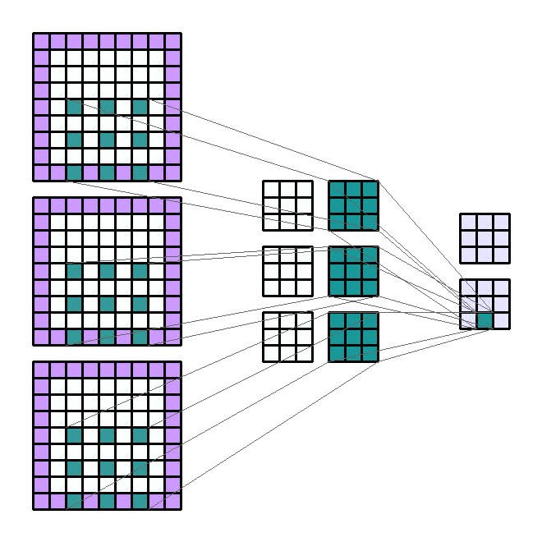

Slide 16
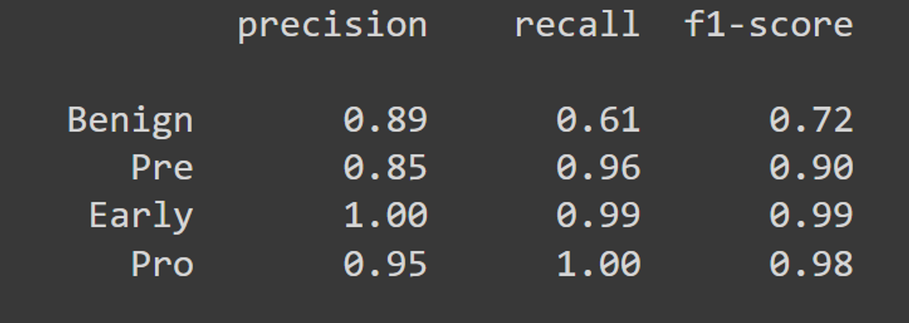
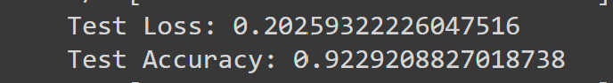
08
Results
Model excels in distinguishing between benign and malignant cases, showing high precision and recall for classes pro, pre, Benign and early.
Relatively lower performance in correctly identifying benign cases, reflected in lower precision and recall values for class 0.
Overall, demonstrates strong performance, particularly in identifying malignant cases.

Slide 17
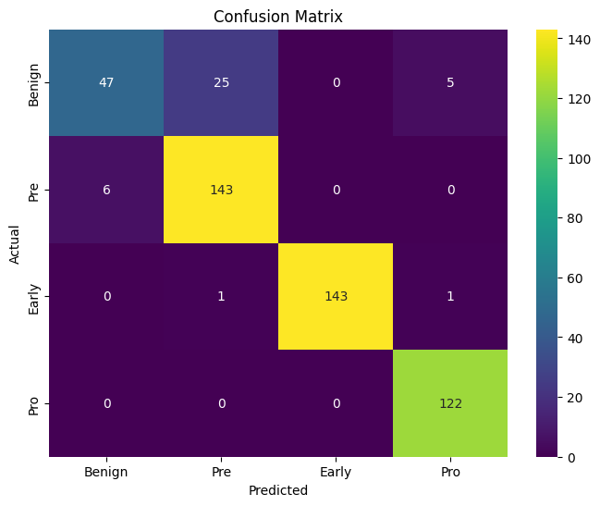
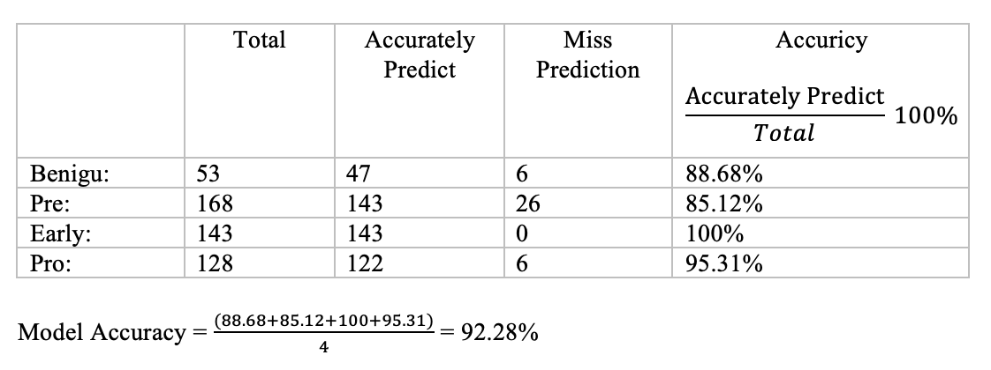
09
Confusion Matrix
Accurately identified "early" , "pre", and "benign" states but confused "pro" states due to the similarity in white blood cell conditions.
The challenge in distinguishing them led to slightly lower precision and recall compared to "early" , "pre" and pro states.
Strong overall performance, especially in detecting malignant states.

Slide 18
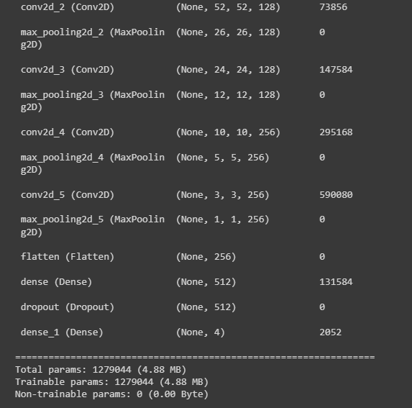
10
Results Comparison
Our trained model is optimized and lightweight compared to previous ones.
Model size: 4 MB, exceptionally lightweight.
Opted for a simple sequential CNN architecture over complex models like PCA-KNN, SVM, neural networks, and ResNet-50.
Achieved commendable accuracy of 92% in acute lymphoblastic leukemia detection.

Slide 19

11
Conclusion
Our study introduces a lightweight CNN model for acute lymphoblastic leukaemia detection.
Achieved a high accuracy of 92%, surpassing previous models.
Model size: 4 MB, ideal for resource-constrained environments.
By focusing on a straightforward architecture, we demonstrate that sophisticated models like PCA-KNN, PCA-CNN, SVM, neural networks, and ResNet50 are not always necessary to achieve accurate results.
Validates deep learning's effectiveness in medical image analysis.
Our proposed lightweight model could serve as a valuable tool in clinical settings, aiding healthcare professionals in timely and accurate detection of leukaemia.

Slide 20




